Slide 1
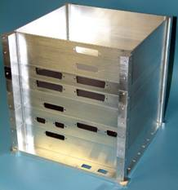
Satellites G4VSS
A look at Amateur Satellites
What’s up there ?
What do they do ?
What equipment do we need ?
Who can use them ?
Notes:
We hope to show satellites from a small selection to show different modes and types available.
How they work.
Demo and gear needed to work the different Sats.
Next go to AMSAT NA web site info

Slide 2
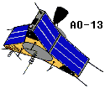
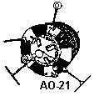
Satellite's
Notes:
From Sputnik to the ill fated AO40 Satellites in different sizes and functions.

Slide 3
Satellite Information
Web Amsat NA website
amsat
A good place for reference
Make a note.
Notes:
Keep the amsat reference page handy
Click on amsat it should open ((note))
Pick up on
ISS not strictly a stand alone satellite but houses APRS node.BBS digipeter and voice repeater.
Now has pcsat 2 aprs bbs high speed packet experiments 1200 baud 9k6 & psk31
Show next slide mounting position.

Slide 4
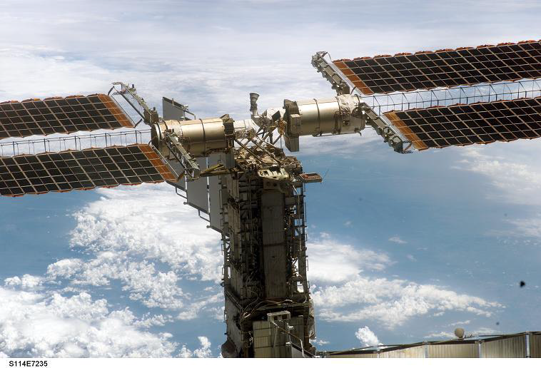
ISS Pcsat 2
pcsat2
Notes:
Possition of PCsat2 on the ISS

Slide 5
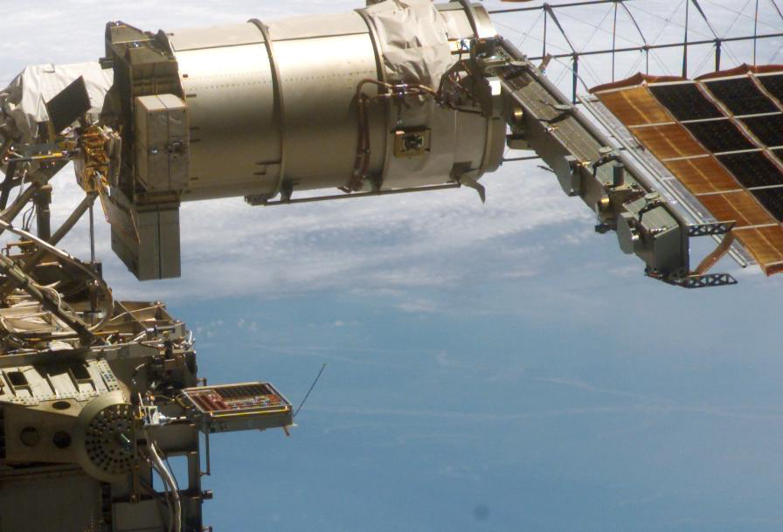
Mounting point on ISS
PCSAT
Notes:
Close up of PCSat 2 position antenna can be seen on this picture
Suitcase taken into space onboard

Slide 6
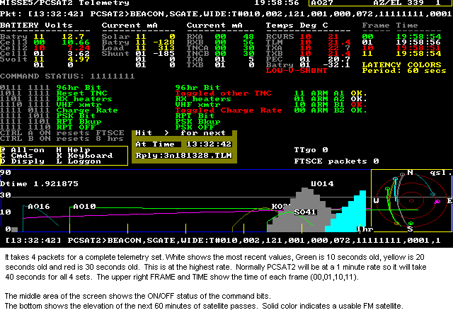
PCSAT 2 Telemetry
Notes:
Nice presentation by telementry program the raw data looks a lot different.

Slide 7
Raw Data
ISSTLM>APRS1,SGATE,WIDE <UI>:
>Side B restored by ZL1AOX 2005 09 26 07:52z
ISSTLM>APRS,SGATE,WIDE <UI>:
{TPJ6sTCYwya48oLJEeZ5MUTpQKA5YABpcAAA8AwQtMDAMMAGYhA2XPHmWyK2W7N2WgQmWhUmOchWM6hmKdh2HPiGKOh2GTiWBmimEciV6fi19Gi14FjFzSjV1s
ISSTLM>APRS,SGATE,WIDE <UI>:
{TP73UeIUM+EUY+IEY+P0U+TUU8T0c8MEg8P0c6SUk6SUk2j0svcU8pEFEia1IbcVQUVVUNtVYGxFcAAlguCgAt/Bot4S4tC2Atc1ssT2MsgWMss2IrUWYrjGUr
Notes:
Telementry take down on 437.975 9K6 Monday

Slide 8
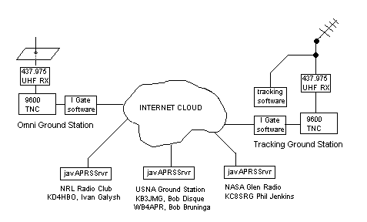
APRS distribution
Notes:
Pcsat 9k6 aprs distribution
It is possible to view on the internet

Slide 9
Oscar AO51
FM voice repeater
PSK31
Data 9k6 & 38.400
BBS
Vhf 145Mhz
Uhf 435 Mhz
Shf 2401.200 Mhz
Notes:
Notes on Oscar AO51 with its Mode’s and Frequencies.

Slide 10
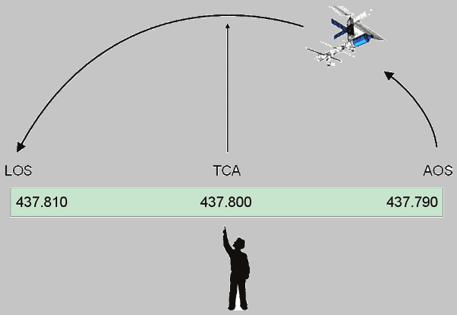
Doppler
Wrong way round ?
437.790
437.810
Notes:
Many examples explain Doppler shift depends how you view from SAT or user>
Approaching train whistle sounds higher in pitch than moving away from the observer.
ISS or any Sat
Don’t trust all you find on internet this was from a website explaining Doppler shift (wrongly)

Slide 11
Doppler Correction
There is a simple rule that works. Well, it’s simple to state, but not simple to use. The One True Rule: tune both the transmitter and the receiver to achieve a constant frequency at the satellite. If everybody did this, there would be no problem with everybody staying together on the same frequency, and there would be no drift through the passband. Nobody would drift off the end of the transponder. Unfortunately, the only way to perform this kind of tuning is by computer control. The computer can use the same Keplerian orbit model that predicts where to point the antennas to predict the Doppler shift for his/her location. The computer can then make continuous small adjustments to both the transmit frequency and the receive frequency, to compensate for the predicted Doppler.

Slide 12
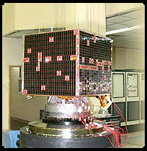
VO52 India’s SAT
Voice uplink on 145 down 435
Sun Synchronous polar orbit
632 km altitude
G4VSS contacts on this Sat
Next
Notes:
VO52 Voice contacts by g4vss

Slide 13
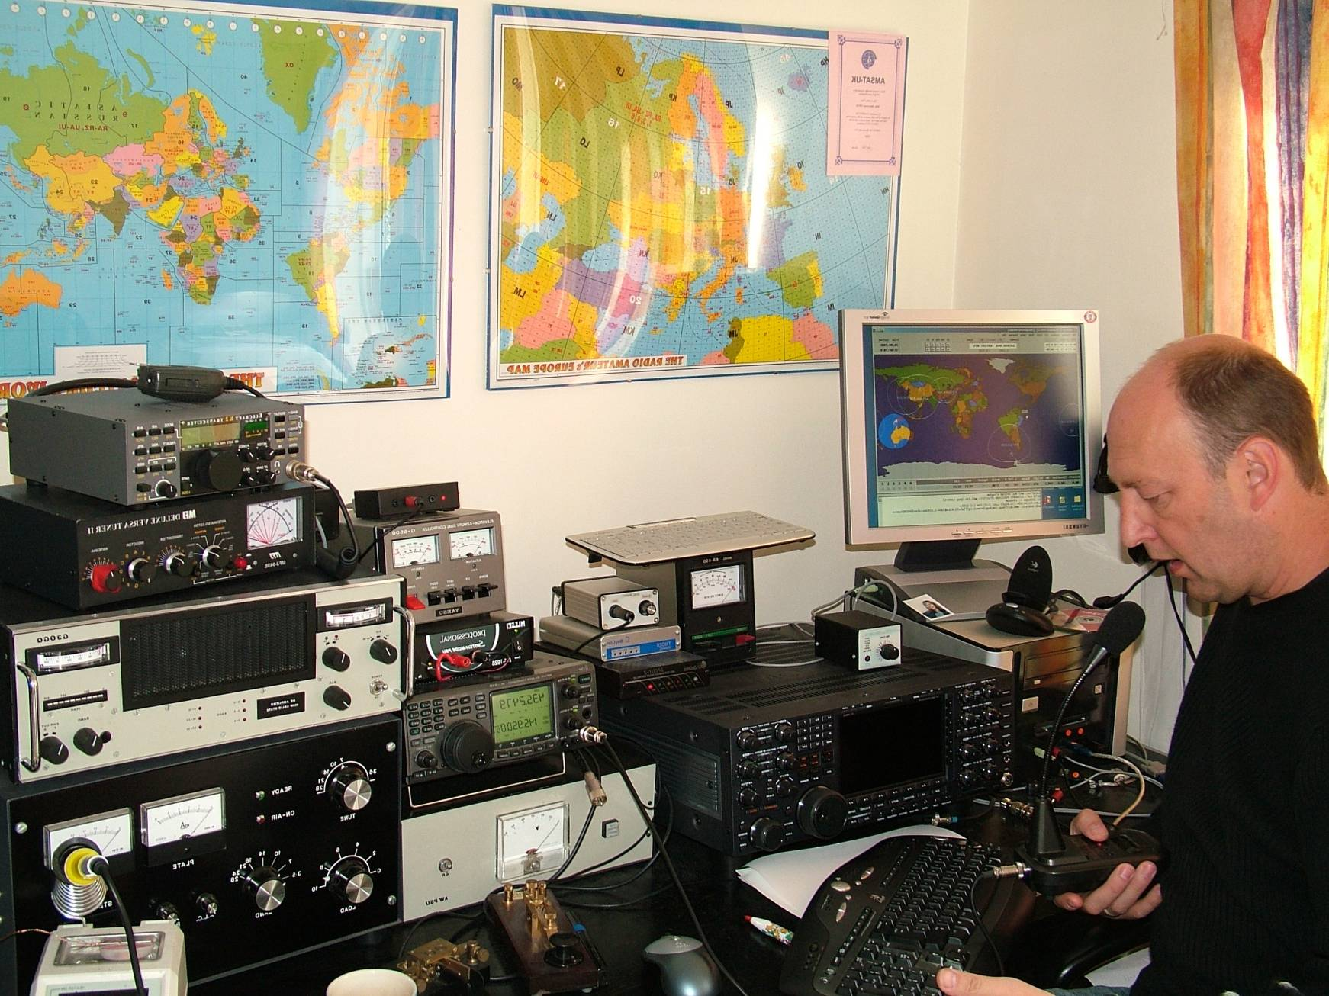
G4VSS Contacts on Hamsat VO52
Notes:
A quick succession of contacts with HB9DSU ON5NY PH7AT on Hamsat VO52
Each contact consists of locator square report and some personel info if time permits like name qth
LEO sats travel fast so each pass even overhead are swift 10 -11 mins
High orbiting sats give longer passes but higher gain antennas are needed

Slide 14
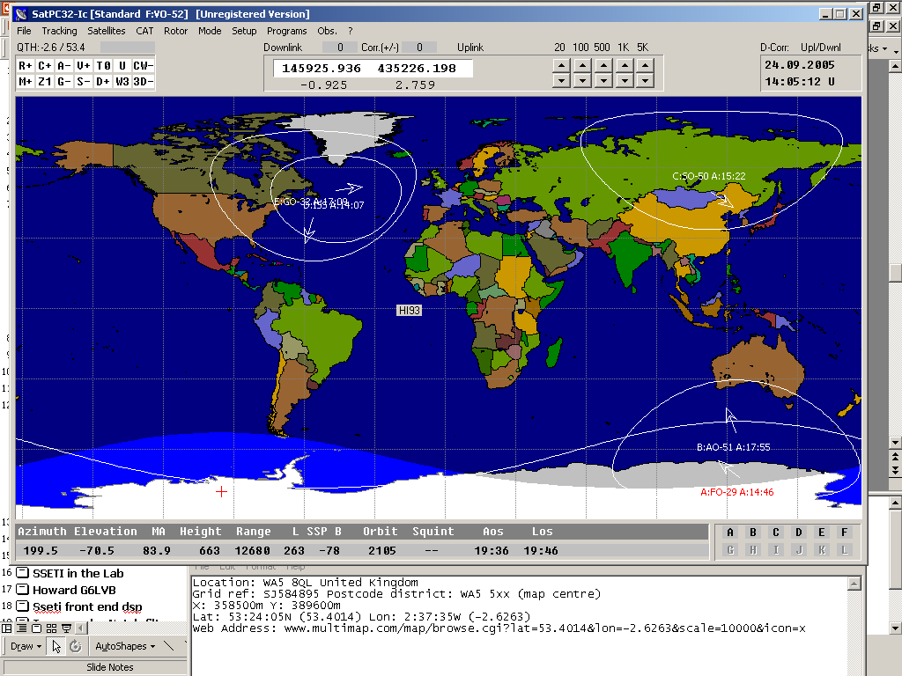
Software
Nova
SatPC32
wisp
Notes:
Nova tracking program with rotator control
Sat PC 32 rotator doppler rig control
Wisp for digi stats rig and tnc control up load down load files

Slide 15
Hardware
Radio’s Satellite equiped
IC 910
TS 2000
Ft 847
Tmd 700 for Pkt plus fm sats
Many separates ft 480 780 etc
Notes:
Current radios multi sat equiped are 910 the 910x has 23cms built in as dose the ts2000 the 736 is an older yasue radio now superseeded by the 920

Slide 16
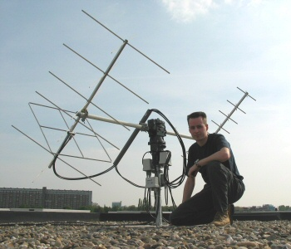
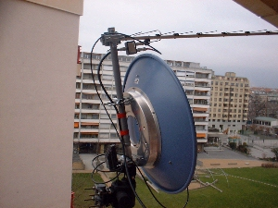
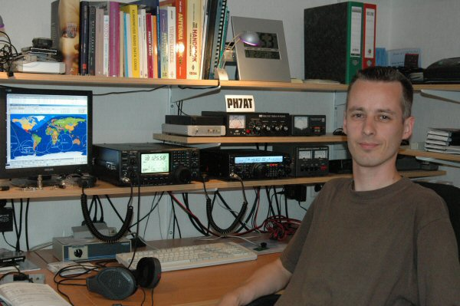
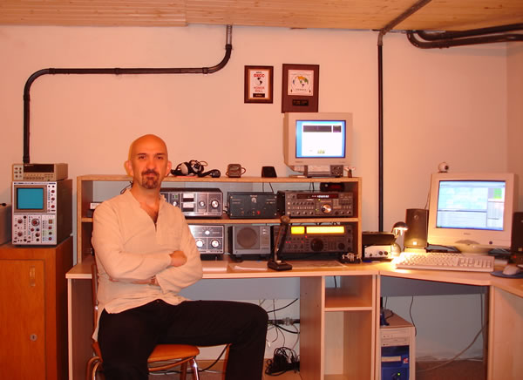
Antennas
PH7AT
HB9DSU
Notes:
As in many aspects of radio depends what you want to do
PH7at uses whimo antenna from germany as this 70cm example

Slide 17
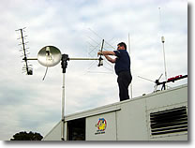
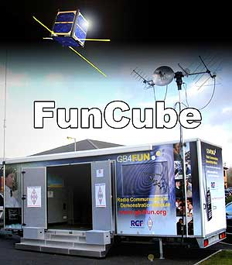
G4FUN Satellite Equipped
Carlos setting up antennas on the old GB4FUN
New GB4FUN promoting a new venture
Notes:
Intro to Fun Cube it’s the future ?

Slide 18
Future Satellites
FUN cube will carry a UHF to VHF linear transponder that will have up to 1 watt and which can be used by Radio Amateurs worldwide for SSB and CW communications. Measuring just 10 * 10 * 10 cm, and with a mass of less than 1kg, it will be the smallest ever satellite to carry a linear transponder and the choice of frequencies will enable Radio Amateurs to use their existing VO-52 or DO-64 station.

Slide 19
The End

